Slide 2
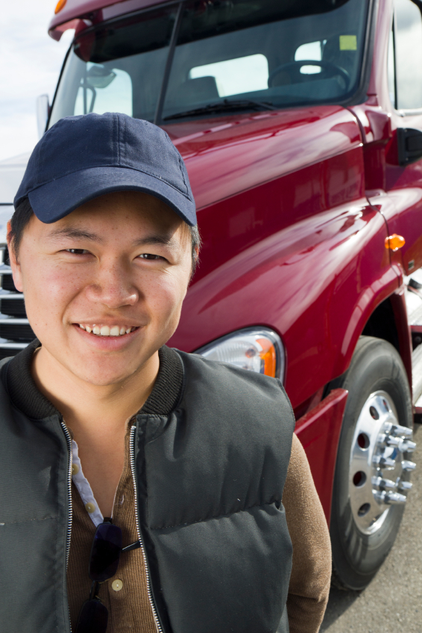
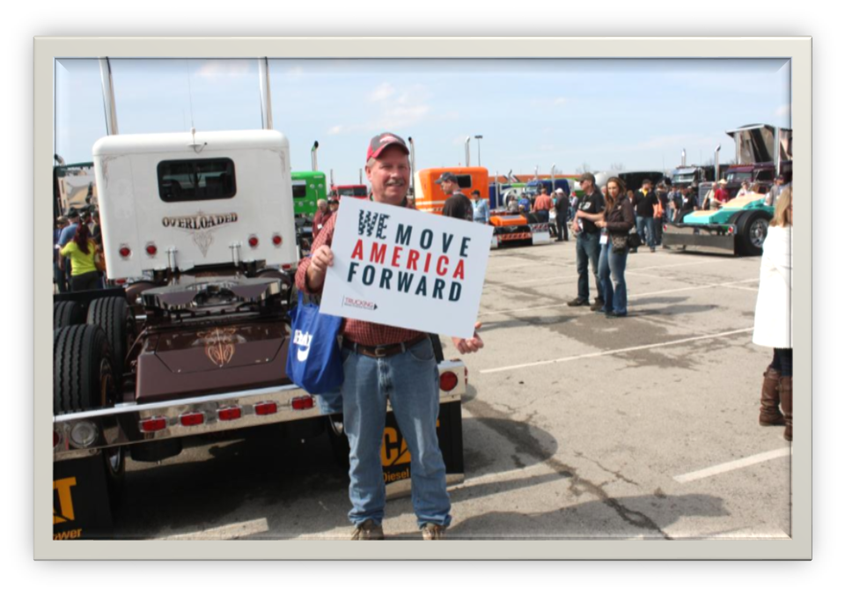
TMAF GUIDE for trucking professionals

Slide 3
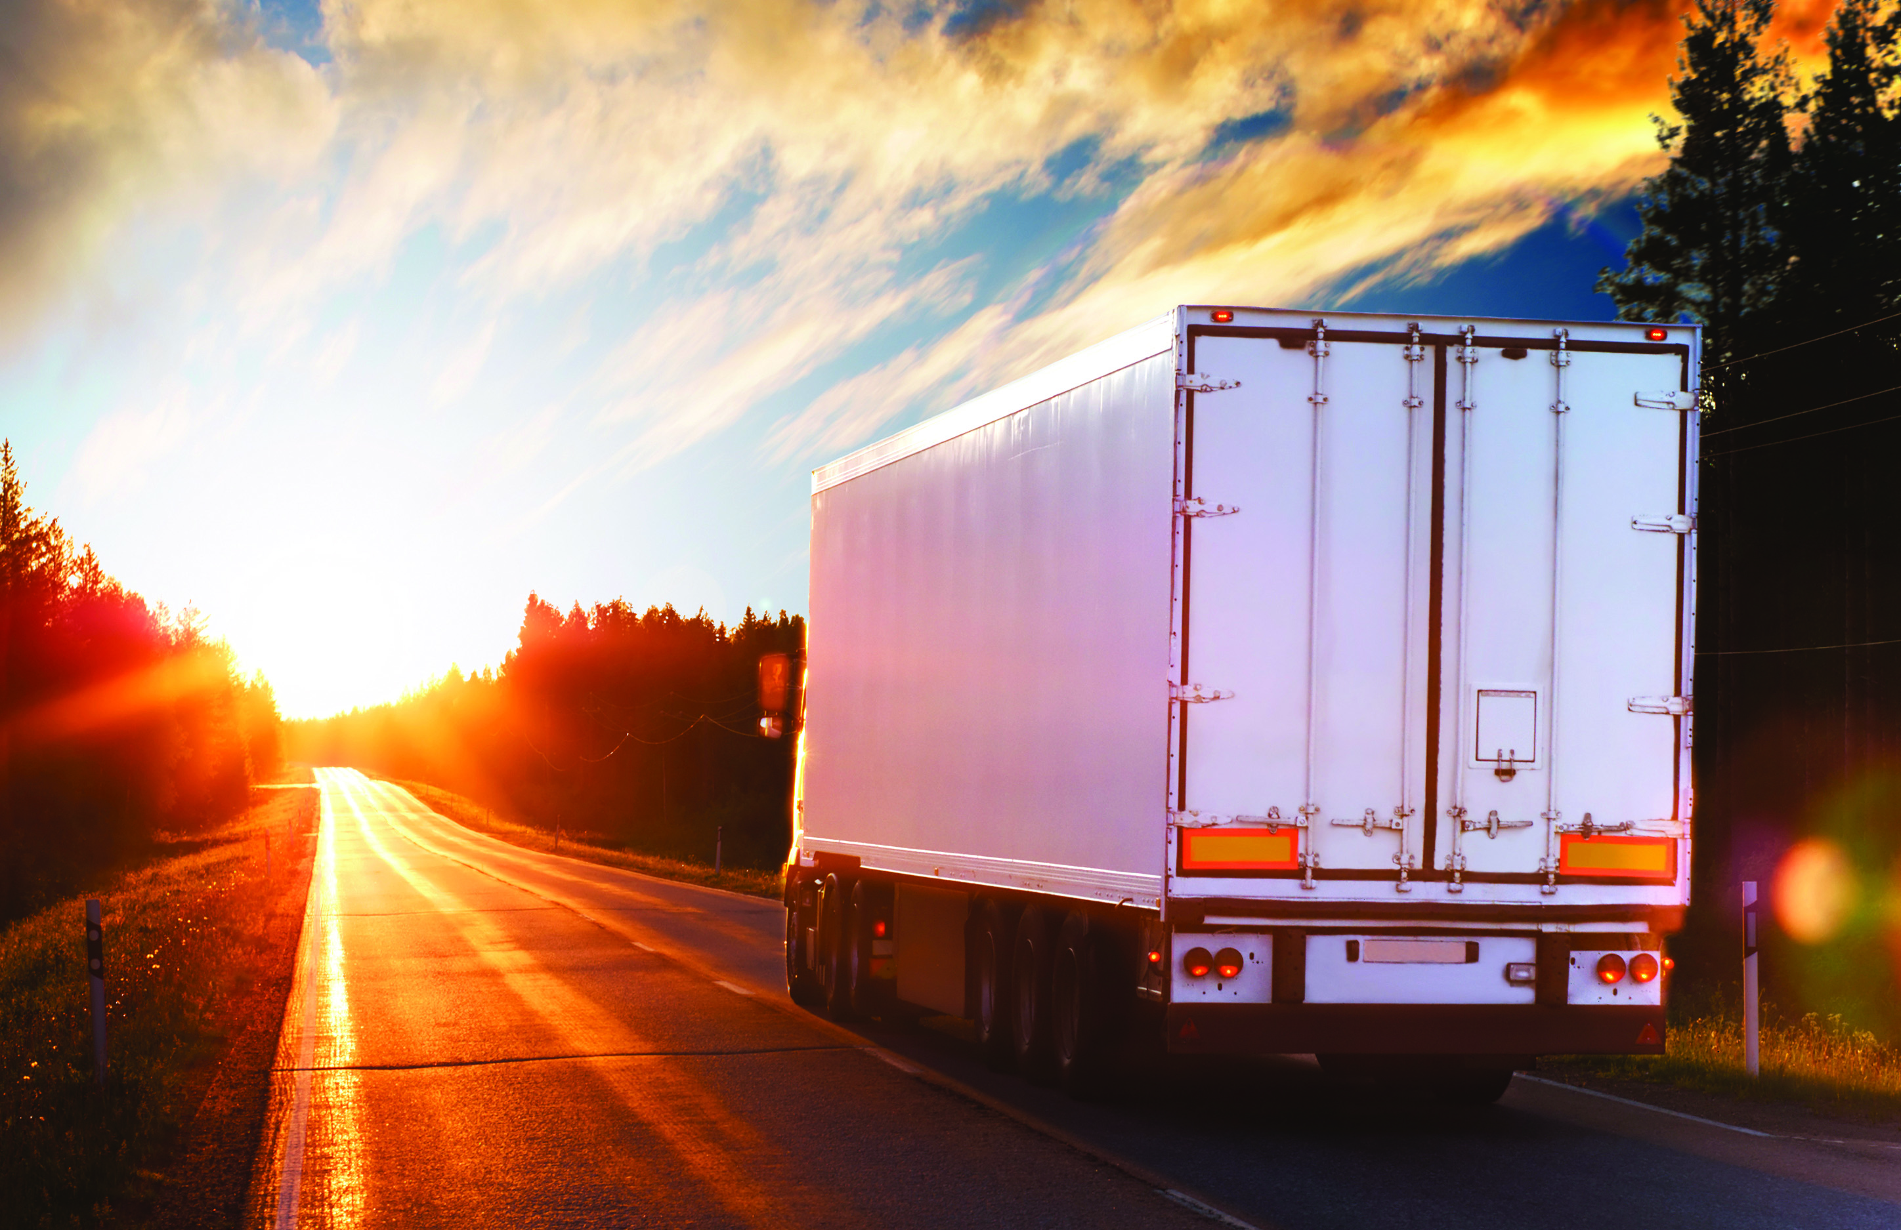
trucking
Every day, millions of trucks travel across the United States to help move America forward.
Students, mothers, homeowners, doctors, business executives and politicians depend on trucks to deliver essential foods, medicines, office supplies, computers, cribs, and other products and goods.
Trucks are critical to our national and global economy, to our families, to our businesses and more.
WHEN TRUCKS STOP MOVING,
THE COUNTRY STOPS MOVING.

Slide 4
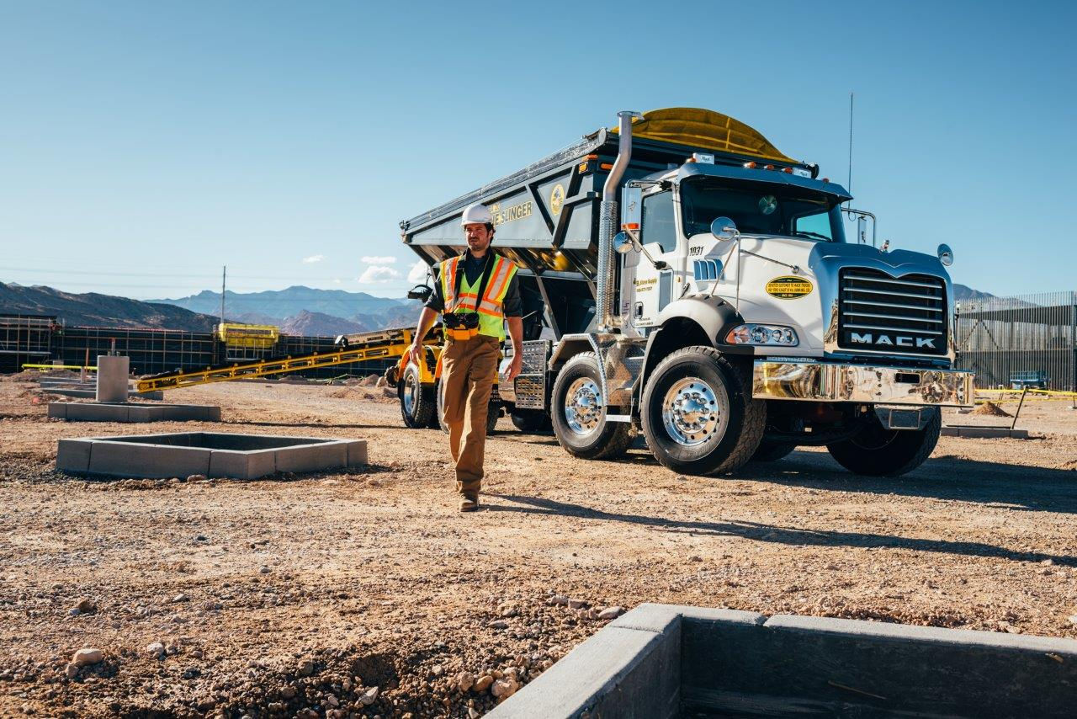
Trucking and The economy
Trucking Powers our Economy
  Trucks transport 70% of the total tonnage in America.
  Trucking stimulates economic activity in every sector of America: healthcare, fuel and transportation, waste removal, retail, food and agriculture, manufacturing and banking.
  Trucking provides the majority of shipping services and movement of goods in the U.S.
  More than 80 percent of U.S. communities rely solely on trucking for delivery of goods.

Slide 5
Trucking and jobs
Trucking is Jobs
  More than 7 million people are employed in trucking jobs.
  3.4 million are drivers.
  90% of truck companies are owner-operated.
  Trucking industry wages were more than $12B in 2013.

Slide 6

Trucking and SAFETY
Professional Drivers are Committed to Safety
  Truck drivers travel over 420 billion miles each year.
  3.4 million professional drivers strive to be accident free.
  The fatal crash rate has fallen 73% since 1973.
  (U.S. Department of Transportation)
  Our industry is committed to educating the public about safety with ongoing programs and initiatives.

Slide 7
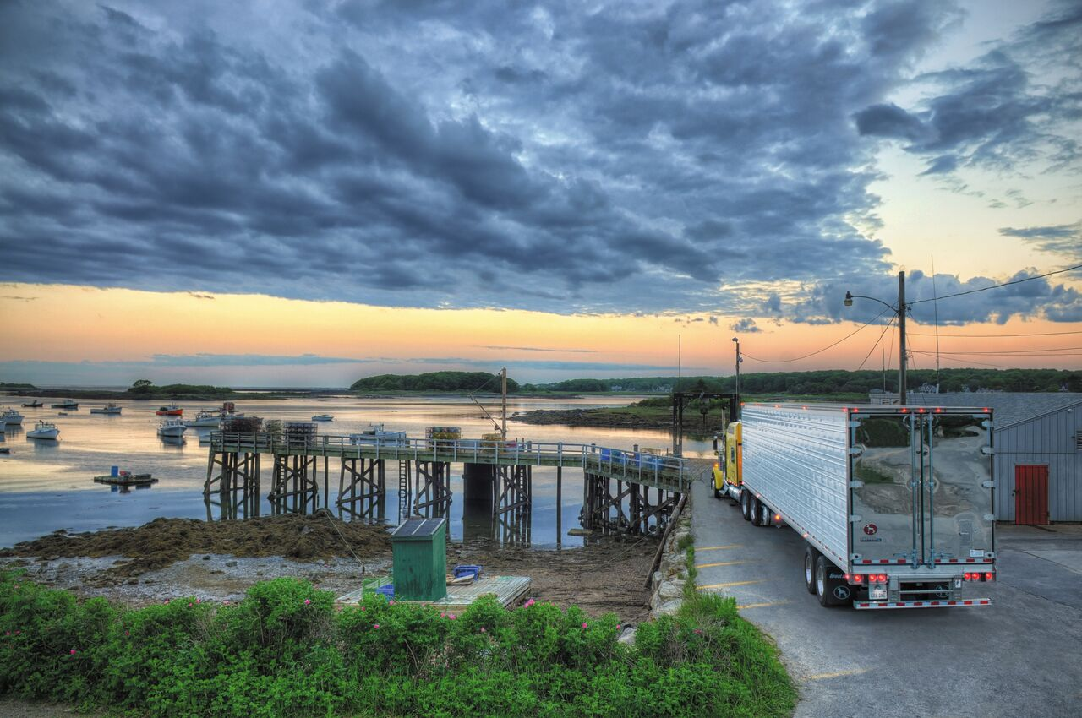
Trucking and SUSTAINABILITY
Trucking is Committed to Reducing our Carbon Footprint
  Many trucks built in 2014 and beyond have adopted new federal rules to reduce emissions.
  A new trucking sustainability program aims to reduce emissions by one billion tons and fuel consumption by 86 billion gallons over a decade.
  Side skirts and green technologies have helped reduce drag, increasing fuel efficiency and lowering overall costs.

Slide 8

a COMMUNITY PARTNER
Drivers Provide Critical Services during Natural Disasters
  Truck drivers connect and grow communities each day, one truck at a time.
  In times of crisis, our industry is there to deliver goods and supplies to help communities rebuild.
  For example, after Hurricane Sandy, as many as 32 food trucks were dispatched, serving more than 500 meals to storm victims.

Slide 9
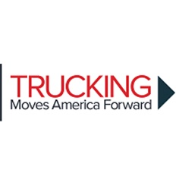
WHY TMAF?
TO EDUCATE THE PUBLIC ON THE IMPORTANCE OF TRUCKING TO AMERICA’S ECoNOMY and all the benefits it offers.
BY TELLING OUR STORY, WE CAN ENSURE THE TRUCKING INDUSTRY REMAINS A THRIVING ONE.

Slide 10
TMAF Mission
Establish a long-term, industry-wide movement.
Members are all levels and types in the industry: drivers, executives, vendors, dispatchers, etc.
We aim to create a positive image for the industry.
We need lawmakers and the public to understand the importance of the trucking industry to the nation’s economy.
We want to build the political and grassroots support to strengthen and grow the industry.

Slide 11


TMAF: What YOU Can DO TO HELP
www.truckingmovesamerica.com
  Sign up for emails.
  Join social media channels
  Use the Member page for:
  -talking points, remarks
  -press materials
  -advertising files
  -videos to download and share
  -trailer wrap information
  -donation information
  Encourage others to join the movement!

